Slide 1
INVESTMENT ARBITRATION
Fair and Equitable Treatment
and Investor’s Due Diligence
Domenico Di Pietro, Partner, GST LLP – London and Miami
and
Andrii Chornous, Head of the International Dispute Resolution practice at Hillmont Partners
Kyiv, Ukraine – December 03, 2021

Slide 2
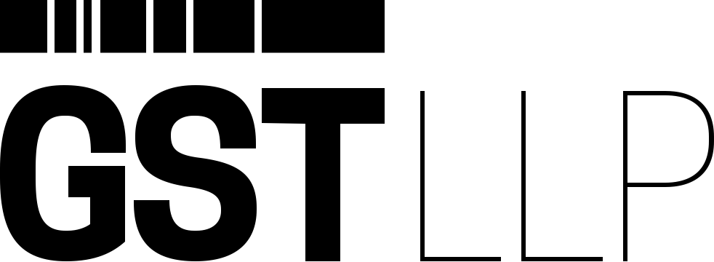
Roadmap
Scope of FET protection in investment treaty arbitration
Legitimate expectations under the FET
The role of due diligence in the assessment of a FET claim
Peculiarities of FET standard application in Ukraine
Conclusions

Slide 3
Fair and Equitable Treatment
FET included in most international investment agreements
Frequently invoked by claimants in investment disputes
Divergence with regard to scope of application, convergence with respect to the elements of FET:
Manifest arbitrariness
Denial of justice and due process
Discrimination and wrongful grounds
Abusive treatment of foreign investors
Protection of legitimate expectations

Slide 4
Legitimate Expectations
Government’s specific representations
Investment-inducing measures
Balanced with the host State’s right to regulate in the public interest
“[n]o investor may reasonably expect that the circumstances prevailing at the time the investment is made remain totally unchanged” (Saluka v. Czech Republic)
Affected by Treaty language and Investor behavior
Necessary circumstances
Substantial and unpredictable changes to the legal framework
Giving rise to serious financial losses

Slide 5
Legitimate Expectations and Due Diligence
Investors’ obligation to perform due diligence
Scope and extent of due diligence obligation
Actual performance of suitable (full, reasonable, sufficient) due diligence
Discharging of obligation is important for both liability and quantum analysis
At liability stage the investor’s due diligence activities can determine whether any legitimate expectations deserving protection have come into existence
A dynamic concept of legitimate expectations entailing positive activity to assess the legislative framework

Slide 6
Key features of FET standard in Ukraine
Most of Ukrainian BITs provide that each contracting party shall ensure FET to investments, although the CIS Treaty and six Ukrainian BITs (with Armenia, Azerbaijan, Croatia, Russia, Tajikistan and Turkey) lack the FET standard.
Three Ukrainian BITs (with Bulgaria, China and Turkmenistan) extend FET standard not only to investments but also to activity connected with investments.
Many Ukrainian BITs extend FET standard, including through combination of this standard with MFN and/or national treatment, to returns on investment (e.g., Argentina, Canada, Greece, India, Panama, Portugal, Singapore).
Several Ukrainian BITs equate the obligation to provide FET under international law or its principles, or provide that the protection is not less favorable than that provided by international law (e.g., Canada, France, Japan, U.S. BITs and ECT).

Slide 7
Types of State conduct challenged by investors as violating the FET obligation
Refusal to issue a permit required for business operations (Lemire v. Ukraine, ICSID Case No. ARB(AF)/98/1);
Continuous interference with activities and management of investment by State tax authority (Tokios Tokelės v. Ukraine, ICSID Case No. ARB/02/18);
Delay in judicial proceedings and other violations of due process (Amto v. Ukraine, SCC Case No. 080/2005);
Deprivation of the investor’s management and control over the investment, as well as failure to establish predictable, consistent and stable legal framework (OAO Tatneft v. Ukraine, PCA Case No. 2008-8).

Slide 8
Conclusions
A breach of the FET standard is one of the most frequent bases for investors claims against a Host State. Currently, a central element of this standard constitutes protection of the investor’s legitimate expectations;
In practice, the investor’s due diligence is considered one of the most important factors in determining a state’s liability for violation of the FET standard. Specifically, investment tribunals evaluate whether an investor has conducted an assessment of risks concerning a regulatory framework it relied on at the time of its investment;
In order to improve the chances of succeeding in proving a breach of the FET standard, an investor should prepare a due diligence report addressing the peculiarities of legislative framework, a state’s political dynamics and different types of risks.

Slide 9
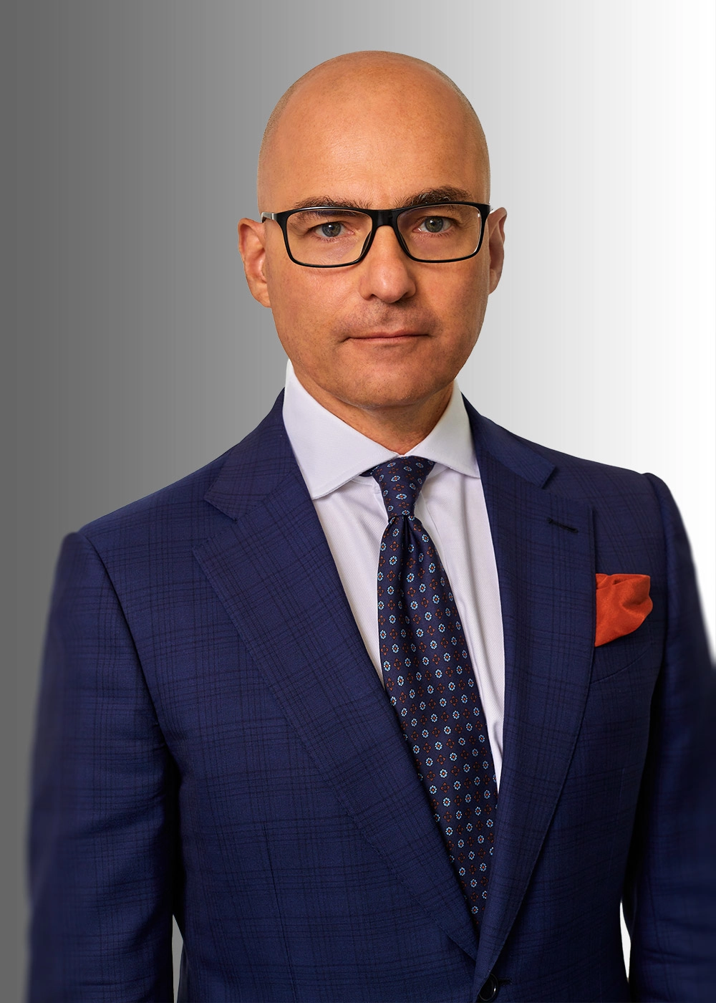
Contacts
Domenico Di Pietro is a Partner at international arbitration boutique GST LLP based in London and Miami. Domenico has practiced international commercial arbitration and investment arbitration for 25 years in jurisdictions as diverse as Italy, England & Wales, Japan and the U.S.
Please contact via domenico.dipietro@gstllp.com

Slide 10
Contacts
Andrii Chornous, PhD, is a Counsel and Head of International Dispute Resolution practice at Hillmont Partners, a British-Ukrainian law firm. He handles complex, high-value matters and specializes in sophisticated litigation as well as commercial and investment arbitration.
Please contact via chornous@hillmont.com

