Slide 1


Ecology and Sustainable Development Forum
Mobilization of investment resources: legal opportunities and risk in Ukraine
Maksym Sysoiev
Partner, Dentons
10 November 2021

Slide 2
FIT for RES in Ukraine
Feed-in tariff (FIT) for commercial projects to be commissioned in 2021-2022
  wind
  (2 MW turbines, if pre-PPA signed before 2020 and commissioned within until the end of 2022 or wind farms up to 5 MW) – 8,8 eurocents per kWh
  solar
    up to 1 MW - 10,6 eurocents (2021) and 10,3 (2022) eurocents per kWh
    rooftop solar - 11,6 eurocents (2021) and 11,2 (2022) eurocents per kWh
    more than 1 MW (pre-PPA before 2020 and commissioned within 2 years after the pre-PPA date) - 7,6 eurocents (until 31 March 2021) and 4,4 eurocents (April-May 2021) per kWh
  biogas/biomass
  12,4 eurocents per kWh
  small hydro
  9,42-15,73 eurocents per kWh (depending on capacity)

Slide 3
FIT for RES in Ukraine
Bonus for local content - 5-20 % (also applies to auctions)
Special FIT for wind (up to 50 kW)/solar (up to 30 kW) installations of households and RES installations of consumers (up to 150 kW)
FIT payable until 2029 (inclusive)
Investment climate was undermined by
  retroactive cut for solar (up to 15%) and wind (7,5%)
  delays in payments and liquidity issues of the
  overall economic, political and pandemic situation and challenges
The payment discipline of the offtaker is improving and steps to tackle past indebtedness are taken
There is a risk that after 2022 will not be available for new facilities
The draft law on feed-in premium creates uncertainty

Slide 4
RES auctions in Ukraine
First auctions were planned in June-November 2021 but have not taken place and unclear when will take place. Issue with sustainability of payments
Considered quotas for auctions during the first year (in total 365 MW)
  wind – 150 MW
  solar – 155 MW
  all other eligible RES – 60 MW
Terms for commissioning
  solar – 2 years
  all other eligible RES – 3 years
  1 year extension may be requested
Term of PPA – 20 years after commissioning
Only projects with secured land rights and grid connection agreement are eligible
Bank guarantee requirements
  EUR 5,000 per MW for participants
  EUR 15,000 per MW for winners (EUR 30,000 MW if 1 year extension is requested)

Slide 5
Corporate PPAs, self-consumption and net metering
Corporate PPAs - most likely future for renewables in Ukraine
However, due to still high transmission and distribution charges and low market prices the large scale projects are not yet considered and not bankable
Currently corporate PPAs for small solar projects located near consumers are structured as lease agreement, EPC with deferred payments, etc.
Most of solar projects are currently done for self-consumption and certain biomass and biogas projects too;
Bankability of projects for self-consumption is growing
Net metering is expected to boost projects for self-consumption
The legislation to create net metering mechanism is still to be elaborated

Slide 6
Energy Storage Facilities and Balancing Facilities
0,2 GW of energy storage facilities were needed already in 2021 for frequency containment
the Ukrainian parliament has not yet adopted the draft law on energy storage facilities but the draft law will not establish any meaningful incentives
grid operators will be able to build energy storage facilities
expected that RES facilities will be able to install energy storage without losing FIT
energy storage faculties might be required for RES auctions
Up to 2 GW of new high maneuvering facilities is already needed in 2021
the auctions for such high maneuvering facilities were heavily discussed but not launched
expected that there will be capacity payments for a certain period of time

Slide 7
Hydrogen and biomethane
There are a lot of talks on hydrogen but realistically only hydrogen strategies are being elaborated
Economics of hydrogen projects are still questionable and no bankability
Politics prevail over economics for hydrogen, e.g. grants for hydrogen projects
Biomethane projects could be implemented in the nearest future
Bankability of projects is high due to the current prices
Recently adopted law on biomethane will help to carry out such projects but the requirements to natural gas and its substitutes shall be adjusted to allow injection of biomethane to the grid
It is possible to transport liquefied biomethane from Ukraine

Slide 8
Energy Efficiency and Waste Mangement
Energy efficiency projects, ESCO, are one of the most important in Ukraine
However, ESCO projects are really small scale and difficult to aggregate
In public sector, it is difficult to get security for ESCO contracts due to issues with public procurement legislation (pledge and assignability of receivables)
As a result, bankability of projects is low
Waste management projects badly needed but badly neglected
Only certain projects could fly, such as landfill gas projects under “green” tariff
Bankability of projects is low due to a number of regulatory issues (tariffs) and lack of mechanisms for securing investments (PPP could help but it is problematic to implement)

Slide 9
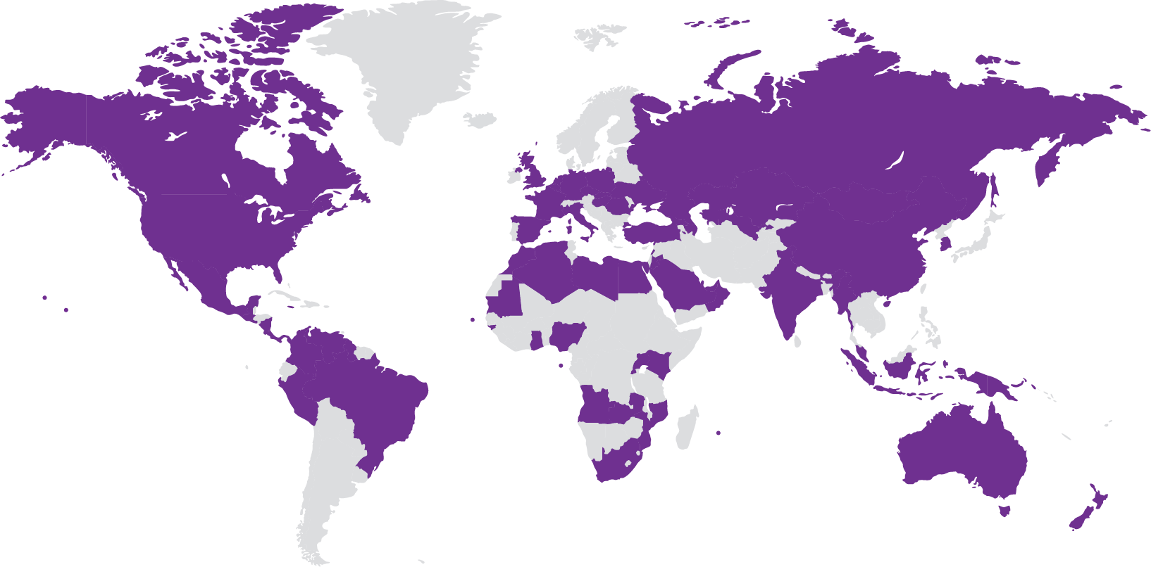
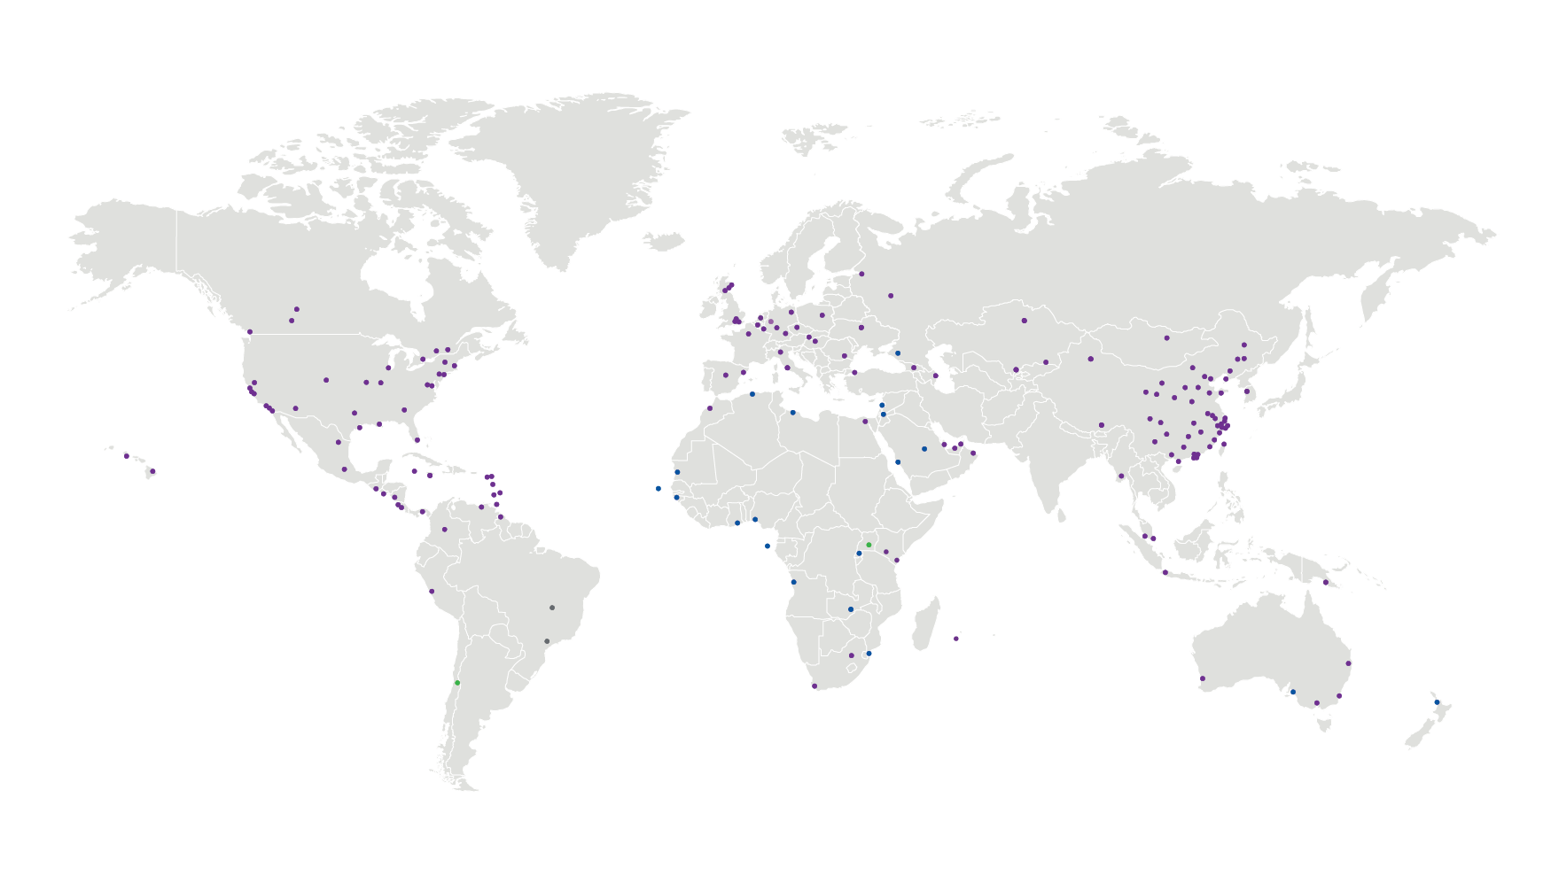

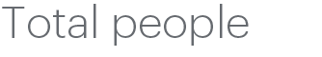





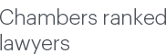
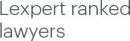
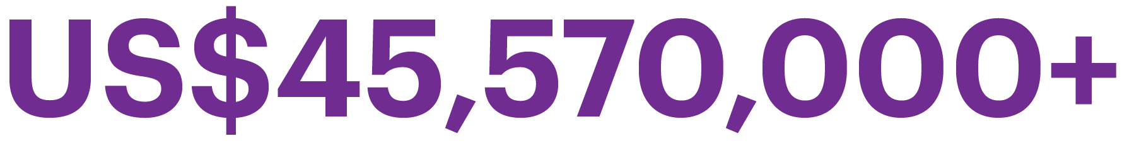
Meet Dentons -
The world's largest law firm
80+
180+
Dentons is the world's largest law firm, delivering quality and value to clients around the globe. Dentons is a leader on the Acritas Global Elite Brand Index, a BTI Client Service 30 Award winner and recognized by prominent business and legal publications for its innovations in client service, including founding Nextlaw Labs and the Nextlaw Global Referral Network. Dentons' polycentric approach and world-class talent challenge the status quo to advance client interests in the communities in which we live and work. www.dentons.com

Slide 10

Dentons’ global coverage
Frankfurt
Dusseldorf
Munich
Luxembourg
Berlin
Amsterdam
Prague
Brussels
Bratislava
Taiyuan
Hohhot
Aberdeen
Warsaw
Xi'an
Shijiazhuang
Edinburgh
St. Petersburg
Ulaanbaatar
Beijing
Glasgow
Moscow
Yinchuan
Tianjin
Edmonton
Ottawa
London
Krasnodar
Lanzhou
Dalian
Calgary
Toronto
Milton Keynes
Tbilisi
Nur-Sultan
Shenyang
Vancouver
Watford
Changchun
Chicago
Montréal
Paris
Kyiv
Almaty
Harbin
St. Louis
Albany
Milan
Tashkent
Urumqi
Jilin
Kansas City
Boston
Barcelona
Istanbul
Baku
Sacramento
Denver
New York
Madrid
Rome
Xining
Jinan
San Francisco
Short Hills
Algiers
Beirut
Zhengzhou
Seoul
Qingdao
Oakland
Dallas
Washington, DC
Casablanca
Tripoli
Amman
Wuhan
Hefei
Changzhou, Nanjing
Silicon Valley
Houston
Tysons
Budapest
Cairo
Lhasa
Los Angeles
Miami
Bucharest
Chengdu
Zhoushan
Ningbo
Nantong
Hangzhou
Shanghai
Suzhou
Wuxi
Orange County
Atlanta
Muscat
Kunming
Honolulu
San Diego
Jamaica
New Orleans
Nouakchott
Dubai
Chongqing
Phoenix
Dominica
Abu
Dhabi
Yangon
Hilo
Monterrey
Cayman Islands
Barbados
Jeddah
Guiyang
Trinidad and Tobago
Riyadh
Doha
Nanning
Mexico City
Haikou
Guatemala City
Guyana
Changsha
Taipei
San Salvador
St. Vincent and
the Grenadines
Lagos
Nairobi
Kuala Lumpur
Wenzhou
Tegucigalpa
Mombasa
Singapore
Fuzhou
Managua
Antigua and Barbuda, St. Kitts and Nevis
Kampala
Huangshi
Xiamen
Liberia
Kigali
Jakarta
Nanchang
Port Moresby
San José
Harare
Guangzhou
Zhuhai
Shenzhen
Hong Kong
Panama City
Port Louis
Lima
Bogotá
Johannesburg
Brisbane
Caracas
Cape Town
Perth
Santiago
Adelaide
Sydney
Auckland
São Paulo
Melbourne
Wellington
Brasília
Locations in purple represent Dentons offices.
Locations in blue represent associate firms, offices and special alliances.
Locations in green represent proposed combinations that have not yet been formalised.
Locations in grey represent Brazil Strategic Alliance

Slide 11


Slide 12
Dentons is the world's largest law firm, connecting talent to the world's challenges and opportunities in more than 75 countries. Dentons' legal and business solutions benefit from deep roots in our communities and award-winning advancements in client service, including Nextlaw, Dentons’ innovation and strategic advisory services. Dentons' polycentric and purpose-driven approach, commitment to inclusion and diversity, and world-class talent challenge the status quo to advance client and community interests in the New Dynamic. www.dentons.com

