Slide 1
Financing Solutions for Managing Risk and Monetizing Assets
International Arbitration Funding
March 2023

Slide 2
Solving Complex Challenges
Domestic and International Commercial Arbitration Cases
Investment Treaty Disputes
Fundable Situations
Award Enforcement
Award Monetization

Slide 3
Risk-sharing Aligns Interests
Our claimant funding allows a law firm to be paid a portion of its fees throughout each case, plus retain the potential of earning part of any award its client receives in the arbitration.
Baseline Model
CLAIMANT FUNDING
Single-Case Financing
Law Firm
CRITERIA
$1M+
$10M+
Claimant
Funding needed per case
Potential recovery (exclusive of punitive damages)
Respondents with ability to pay judgments (enforcement services available from our team)
Omni Bridgeway
Strong likelihood of success

Slide 4
Investment Considerations
Qualifications and arbitration-specific experience of counsel
Documentary and witness evidence on factual issues
Experts on liability and damages issues
Collectability of the award
Likely time to collection of the award
Security for costs
Adverse costs awards

Slide 5
About Us
I was very impressed with the way Omni Bridgeway's team analysed a complicated legal situation from both a practical and legal standpoint. They clearly understand the dynamics of what drives judges and jurors in their decision making. They are also an effective and balanced team. All are strong intellectually and each has a useful background and expertise. They respect each other, listen carefully, and work together.
A dispute funding relationship can last years. Choosing the right funding partner is critical to your success.
We have unmatched experience.
ABRAHAM D. SOFAER, (FORMER DISTRICT COURT JUDGE, SDNY) CHAIRMAN, FEDARB
GEORGE P. SHULTZ, SENIOR FELLOW THE HOOVER INSTITUTION, STANFORD UNIVERSITY

Slide 6
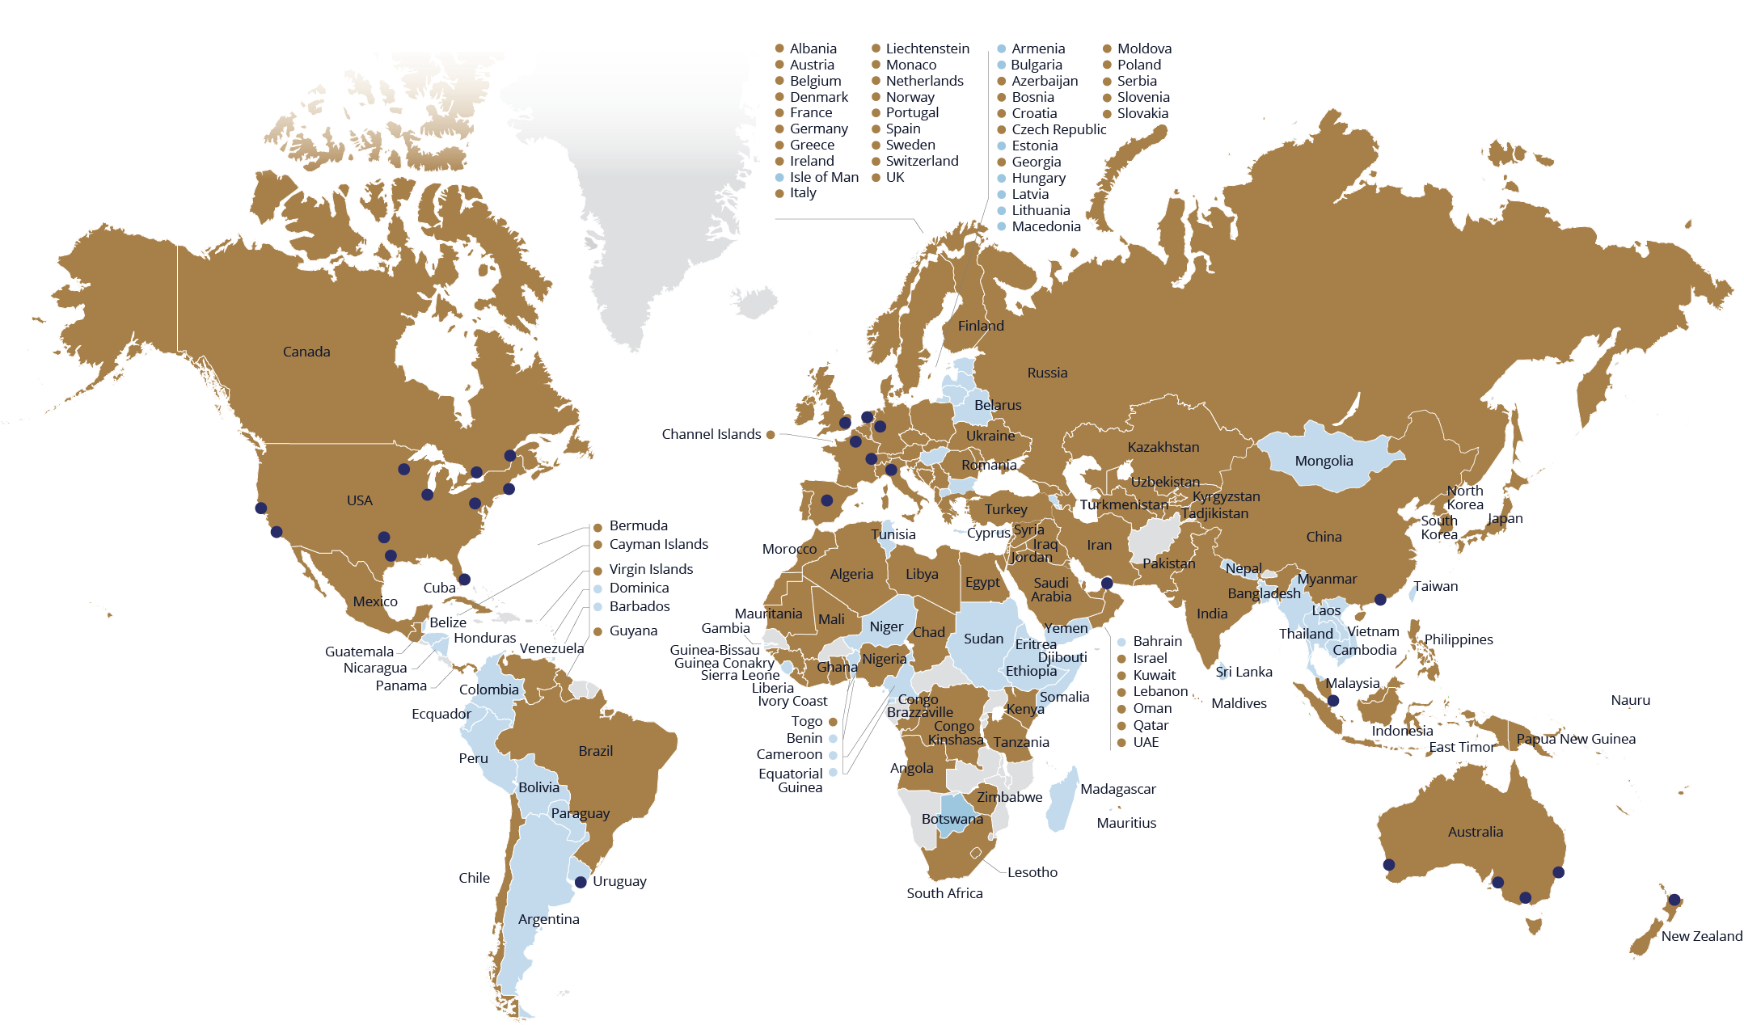
Global expertise
Disputes, settlement, enforcement and recoveries
Funded^{1,2} and/or managed (litigation, arbitration and/or enforcement and recovery)
Assessed²
Omni Bridgeway cities / agents / other
1 | Non-recourse financing of domestic or international arbitration, litigation (individual claimant or group litigation) and enforcement and recovery action.
2 | Reflects locations of parties, disputes, proceedings, enforcement actions.

Slide 7
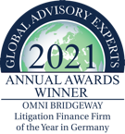
Industry acknowledgement
LITIGATION FUNDING:
THE ONLY BAND 1
Australia, South East Asia, Canada (2021-22)
Middle East (2022)
Asia-Pacific (2019-20)
BAND 1
Europe (2021-22)
USA (2018-22)
Latin America (2022)
Global Asset Tracing & Recovery (2020-22)
International Arbitration (2022)
BAND 4
UK (2020-2022)
INTELLECTUAL PROPERTY:
Band 2 US (2021, 2022)
INSOLVENCY:
Band 3 UK (2022)
GLOBAL 100 LEADERS IN LITIGATION FINANCE:
Team members recognised (2016-22)
GLOBAL 500 RESTRUCTURING AND INSOLVENCY ADVISORS:
Team members recognised (2020)
LITIGATION FUNDING PROVIDER:
Number 1 'Litigation Funding Provider' (2017, 2018)
LAW FIRM FUNDING:
Recognised in ‘Best of’ list for “Law Firm Funding' (2017, 2018)
FT INNOVATIVE LAWYERS AWARDS – ASIA PACIFIC HIGHLY COMMENDED:
Funding of SIAC arbitration with leading international law firm (2019)
CANADIAN LAWYER READERS’ CHOICE AWARD:
Recognised as a Top Litigation Funder (2018, 2019, 2020)
COMMERCIAL LITIGATION FUNDING PROVIDER:
Number 1 litigation funding provider in ‘Best Of’ list (2018)
Recognised in ‘Best Of’ list (2017)
ARBITRATION & DISPUTE RESOLUTION:
3 team members recognised, ‘Best Litigation Funder Arbitration’ (2022)
LITIGATION FUNDERS:
Ranked ‘leading’ and ‘excellent’ and ‘Highly recommended’ for litigation and arbitration funding in the UK, US, LATAM and Europe (2019, 2020, 2021, 2022)
5 team members recognised (2022)
INNOVATION AND EXCELLENCE AWARDS:
1 team member recognised, ‘Excellence in Class Action Services’ (2017)
Litigation Finance Firm of the Year (Germany, 2021)
GLOBAL ADVISORY EXPERTS:
Litigation Finance Firm of the Year (Germany, 2021)
COMMERCIAL LITIGATION FUNDING PROVIDER:
Recognised in ‘Best of ’ list for ‘Commercial Litigation Funding Provider’ (2017, 2018)
PROFESSIONAL LIABILITY INSURANCE PROVIDER:
Recognised in ‘Best of ’ list for ‘Professional Liability Insurance Provider’ (2017, 2018)
WHO’S WHO LEGAL THOUGHT LEADERS:
More team members recognised than any other funder (2020-22)
WHO’S WHO LEGAL ARBITRATION:
Team members recognised (2020, 2022)
CORPORATE INTL AWARD:
Litigation Finance Firm of the Year (Germany, 2021-2023)
ACQUISITION INTERNATIONAL GLOBAL EXCELLENCE AWARD:
Leaders in Litigation Funding Services (Germany, 2021, 2022)
THE LAW FIRM FUNDING PROVIDER:
Recognised in ‘Best of ’ list for ‘Law Firm Funding provider’ category (2019, 2020, 2021)

