Slide 1
UKRAINIAN ARBITRATION FORUM 2020
11 November 2020
COVID 19 AND FORCE MAJEURE POSITION ON INTERNATIONAL OIL & GAS CONTRACTS
Marco Pocci

Slide 2
Introduction
Force majeure. What is it?
How to rely on Force Majeure? English law position
What are the consequences of calling Force Majeure?
Mitigating or avoiding the Force Majeure event?
Can IOCs call Force Majeure in anticipation of a force majeure event?
If there is another reason as well as the Force Majeure event that is preventing performance, can I still rely on the Force Fajeure event?
What happens if Force Majeure event is wrongly called?
What if there is no Force Majeure clause in the contract?

Slide 3
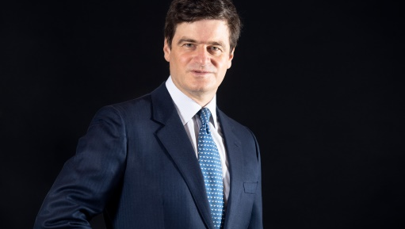
Contact
Marco Pocci
Partner
T: +852 2533 2748
E: marco.pocci@shlegal.com
Marco specialises in representing energy and infrastructure clients all over Asia and the rest of the world in a wide range of issues, including regulatory and general counseling, the negotiation of contracts and agreements related to project development, and financing and construction, among others.
Marco has represented a wide diversity of players in the energy industry ranging from utilities, independent power producers, energy cooperatives, project developers, financiers, and power purchasers, to manufacturers, oil and gas companies, retailers, contractors, lenders, borrowers, investors, traders, and governments, among others.
Marco's energy experience extends to virtually all types of energy projects, including conventional fossil-fueled, gas- and coal-fired, combined-heat-and-power, renewable and alternative energy (especially wind, solar, biomass, and geothermal).
Marco is a registered foreign lawyer (England & Wales and Italy) in Hong Kong.

