Slide 1
FOSFA Arbitration
Orest Matviychuk
Senior Associate, CMS Cameron McKenna Nabarro Olswang

Slide 2
Questions to be discussed
What is FOSFA?
FOSFA Contract Forms
FM under FOSFA contracts
Overview of FOSFA arbitration system
What does it mean to be ‘posted’?

Slide 3
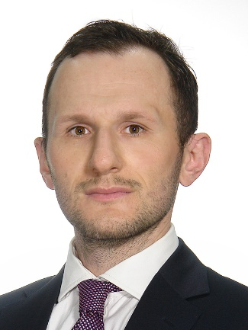
Thank you!
Orest Matviychuk
T +380 44 391 3377
E Orest.Matviychuk@cms-cmno.com
CMS Cameron McKenna Nabarro Olswang
38 Volodymyrska Street, 6th Floor | Kyiv 01054 | Ukraine
Follow us:
Facebook https://www.facebook.com/cmscmckua/
LinkedIn https://www.linkedin.com/company/10822897/
Twitter https://twitter.com/CMS_law

