Slide 1
7955 COMPLAINTS RECEIVED BY 01 NOVEMBER 2020
2016
2017
2018
2019
2020

Slide 2
KEY SUBJECTS OF COMPLAINTS

Slide 3
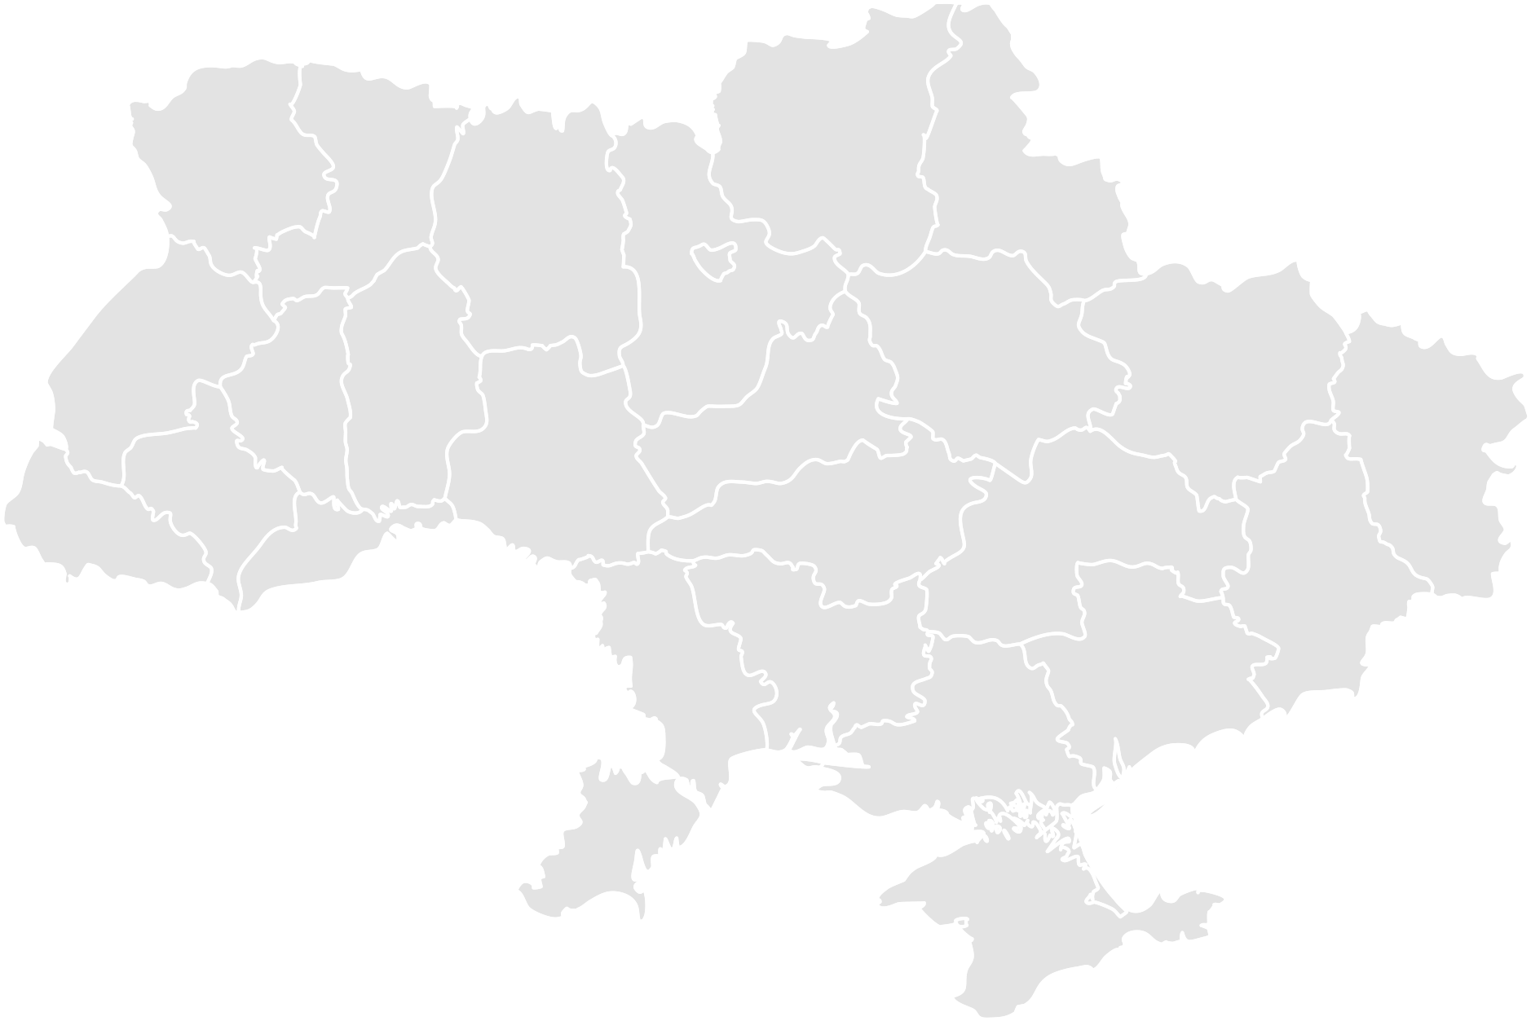
GEOGRAPHY OF RECEIVED COMPLAINTS
Rivne region 84
Chernihiv region 110
Volyns’ka region 94
KYIV 3071
Sumy region 88
Zhytomyr region 118
L’viv region 236
Kyiv region 649
Poltava region 150
Ternopil region 66
Khmel’nyts’ka region
110
Kharkiv region 591
Cherkasy region 170
Luhans’k region 54
Vinnytsya region 81
Ivano-Frankivs’k region 105
Zakarpats’ka region 77
Kirovohrads’ka region 126
Dnipropetrovs’ka region 639
Chernivtsi region 38
Donets’k region 165
Mykolayiv region 175
Zaporizhzhya region 365
Odesa region 489
Kherson region 102
Crimea 2

Slide 4
KEY FACTS 2015-2020
(as of 01.11.2020)
7955 complaints received and 5307 cases are closed
89% individual rеcommendations implemented
16 systemic reports published
37% of systemic recommendations implemented
72% complaints are from small and medium business
83% complainants are local companies
UAH 18 699 288 375 direct financial impact
98% complainants are satisfied with cooperation
TOP-5 most active regions: Kyiv (39%), Dnipropetrovsk region (8%), Кyiv region (8%), Kharkiv region (7%), Оdesa region (6%)

